Slide 1
Academic Consultation Booking

Slide 2
Case Statement
Traditional methods of scheduling appointments require students to meet faculty in person, resulting in wasted time, conflicts in scheduling, and inefficiencies.
🔹 There is no unified platform where students can check teacher availability and instantly book an appointment.
🔹 Communication barriers occur when students are unable to confirm, reschedule, or cancel their appointments.
Solution
We propose an online appointment scheduling system that enables:
🔹 Students to schedule and manage their appointments digitally.
🔹 Teachers to efficiently review, accept, or decline appointments while managing their availability.
🔹 Administrators to monitor user registrations and ensure the system functions smoothly.

Slide 3
core Objectives Aims
✔ Minimize wait times by enabling students to schedule appointments online. ✔ Improve efficiency in organizing student-teacher meetings. ✔ Facilitate instant communication through messages and notifications. ✔ Securely store appointment records using Firebase. ✔ Guarantee accessibility on both mobile and web platforms.

Slide 4
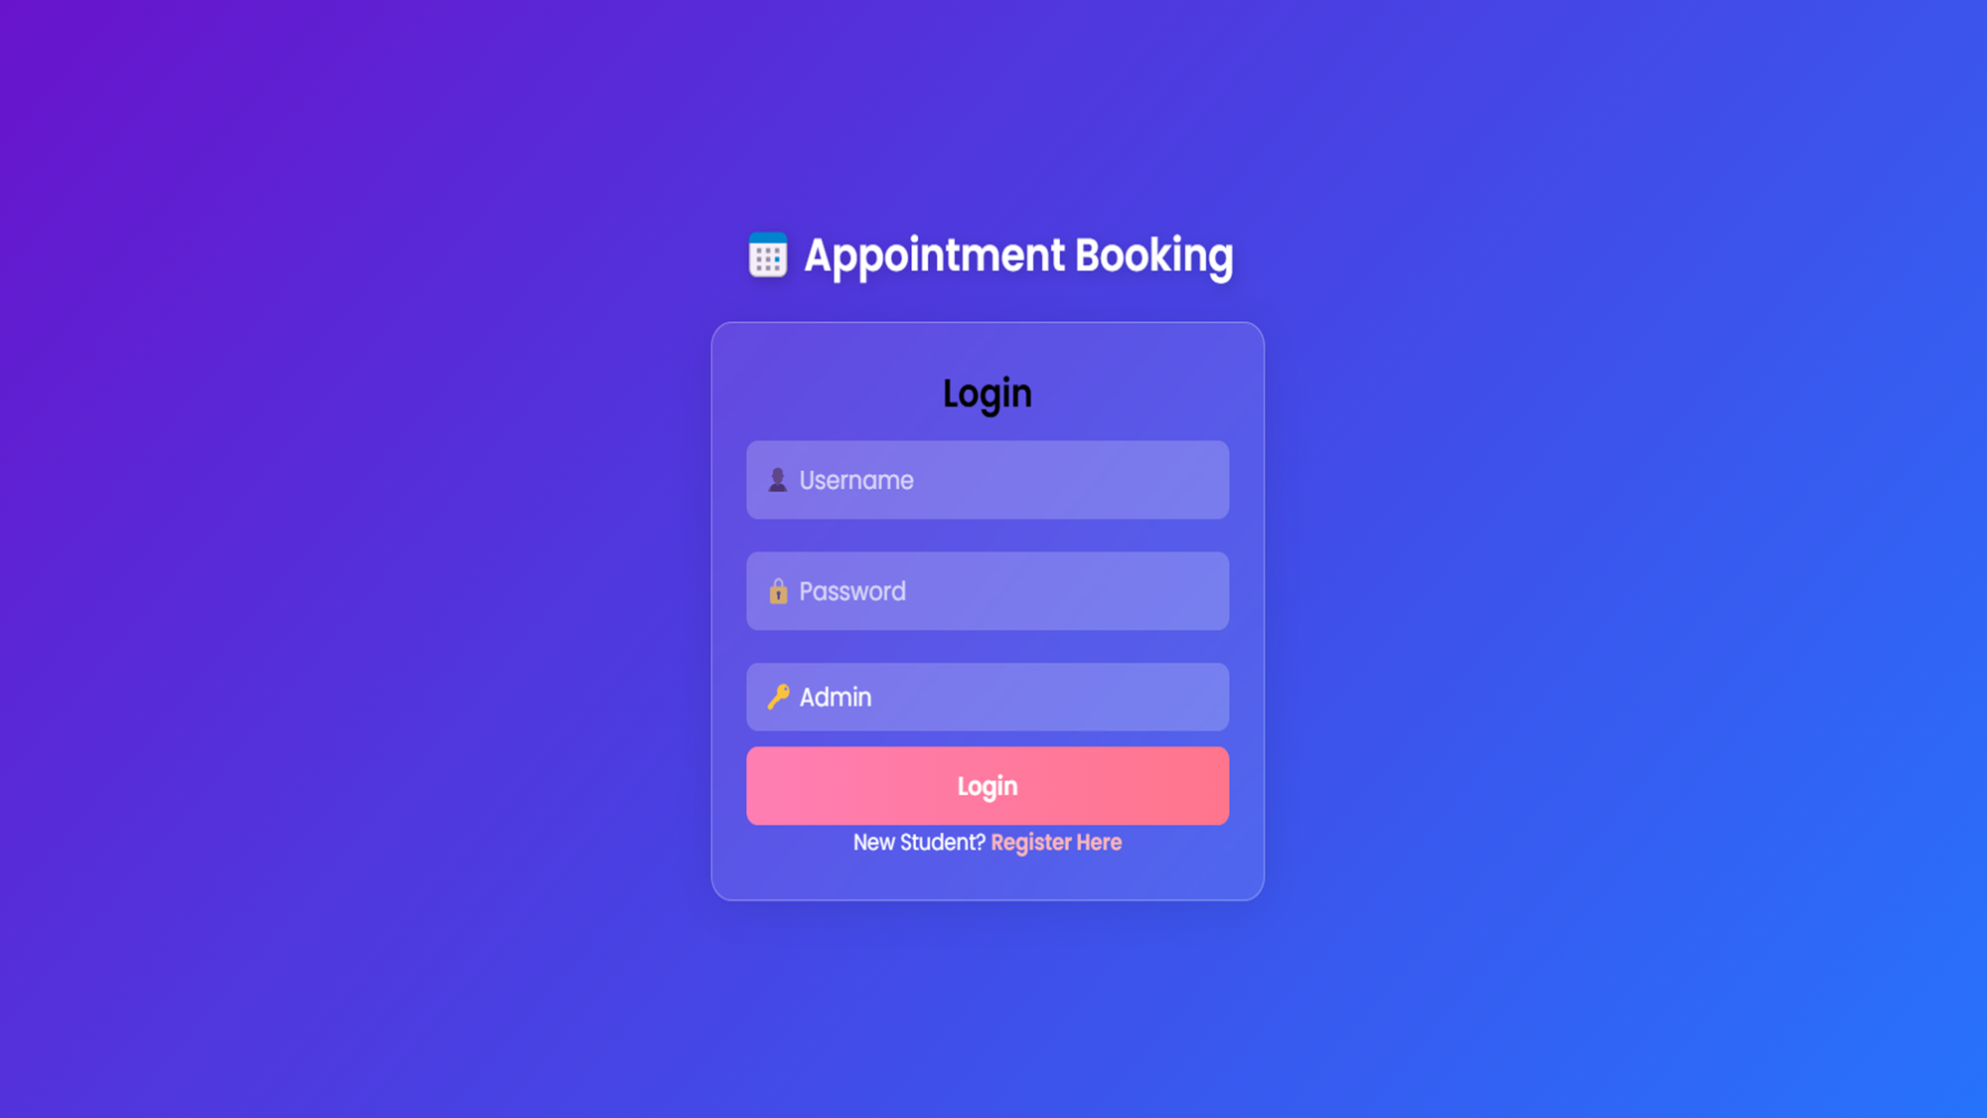


Slide 5
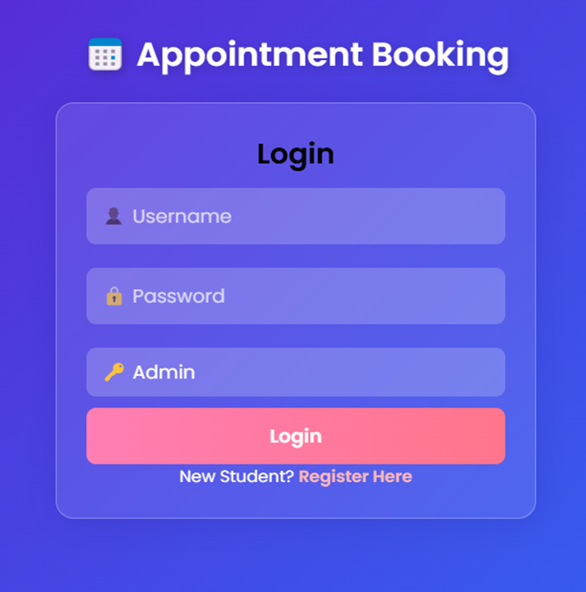

Key functionalities
Unlocking new horizons

Slide 6
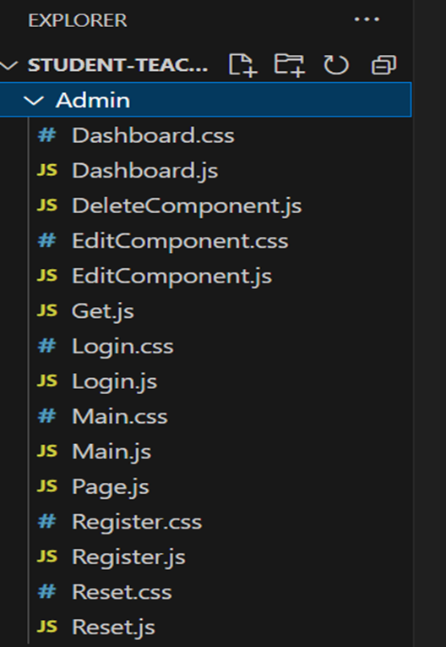

Management Functions
✔ Create, modify, and remove teacher records.
✔ Review and decide on student registration requests.
✔ Oversee and maintain the appointment and user database.

Slide 7

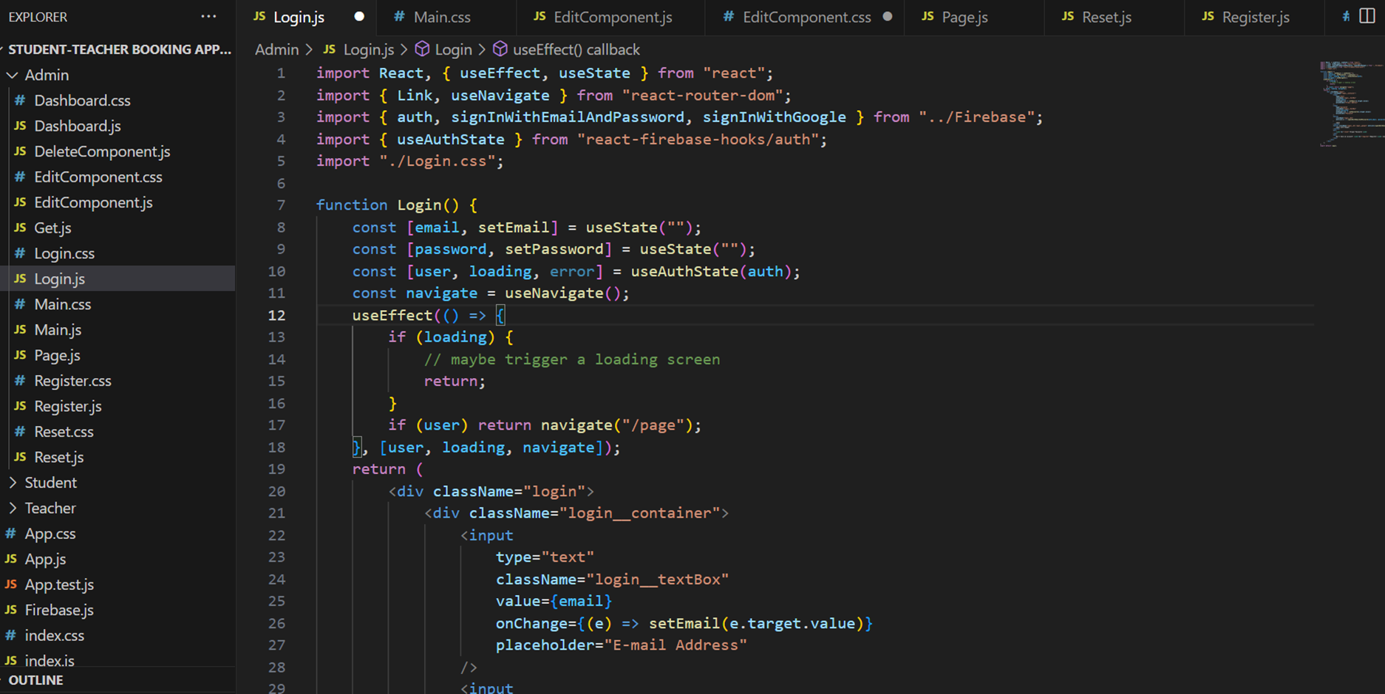

Slide 8
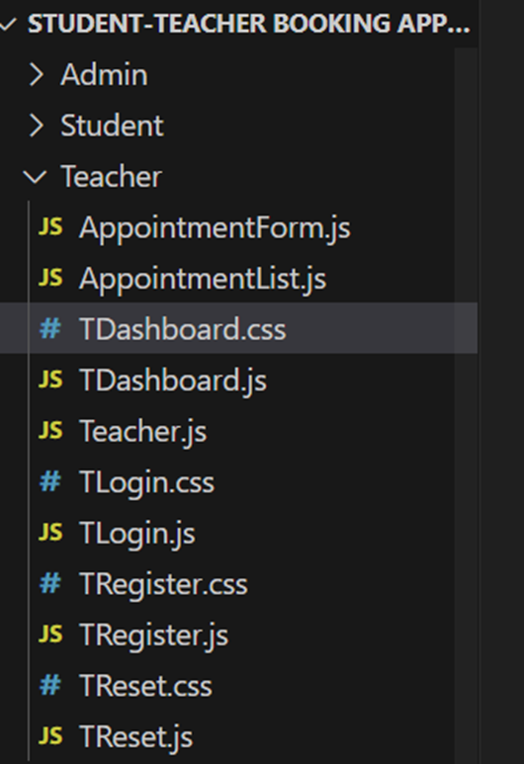
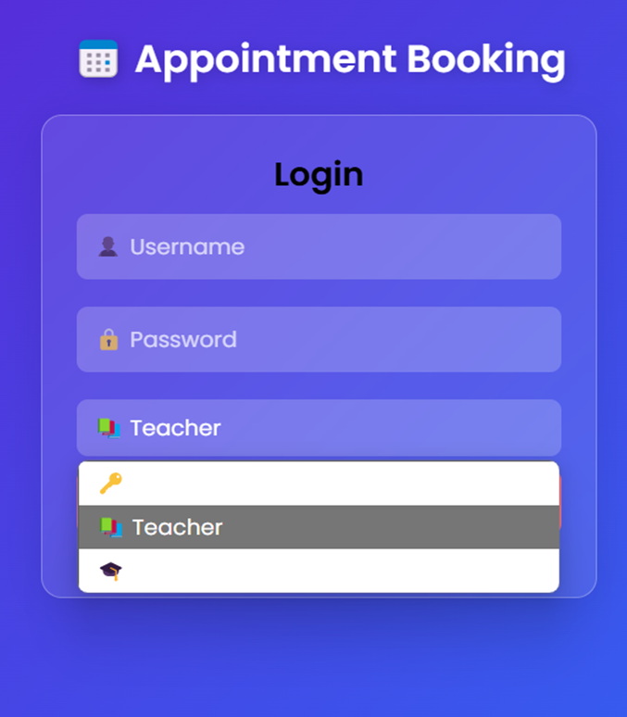
Teaching Dashboard
✔ Sign in securely with Firebase authentication. ✔ Book, approve, or cancel appointments. ✔ Access a list of upcoming appointments. ✔ Read and reply to student messages. ✔ Sign out safely.

Slide 9

Marketing strategies

Slide 10
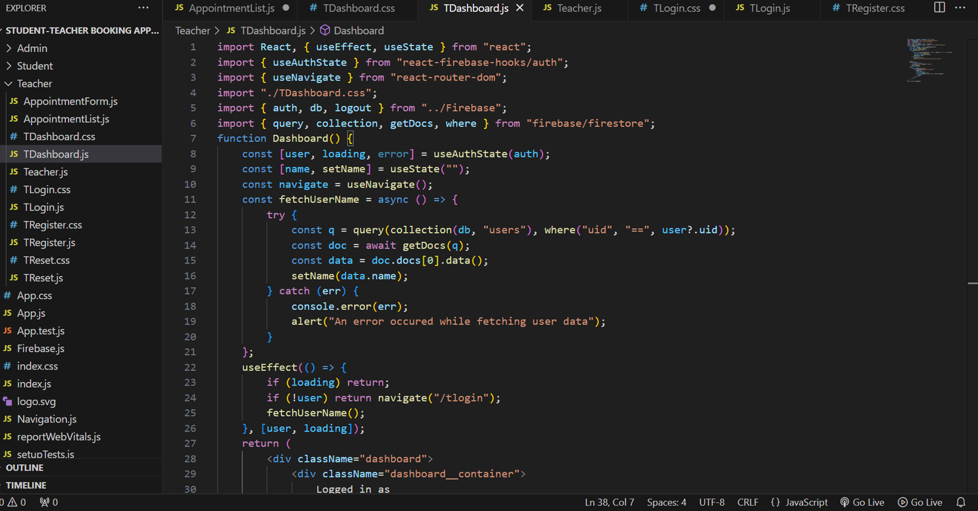

Slide 11
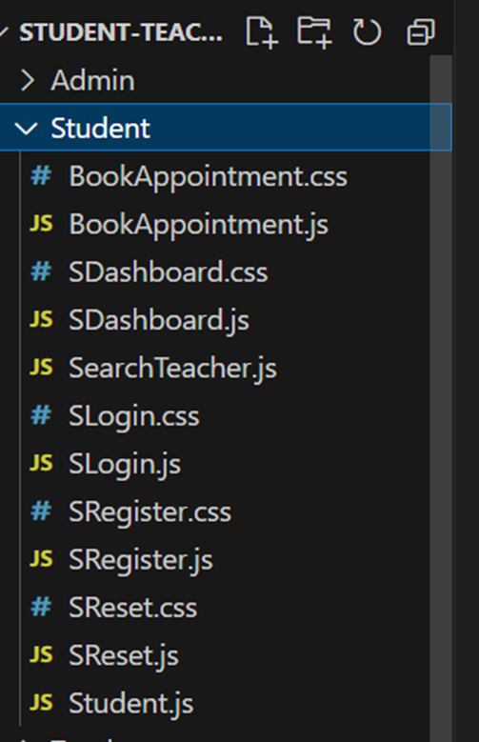
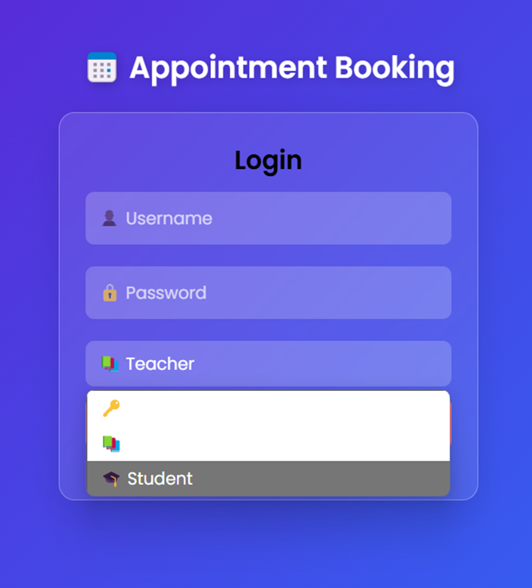
User tools
✔ Sign up and access the system securely. ✔ Find teachers by department or subject. ✔ Schedule appointments online. ✔ Communicate with teachers via messages.

Slide 12
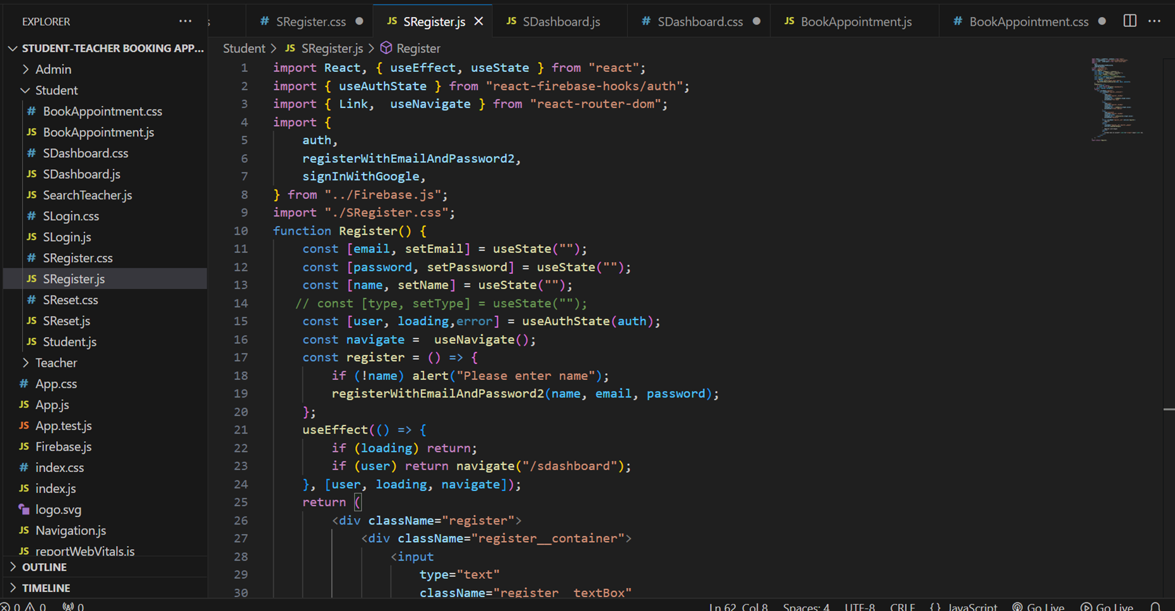


Slide 13
1. The student browses for teachers and chooses an open time slot. 2. The teacher instantly accepts or declines the request. 3. The admin oversees registrations and ensures seamless operations. 4. Firebase securely stores and dynamically updates all data.
🔹 Include a System Architecture Diagram displaying:
Users: Student, Teacher, Admin
Frontend: HTML, CSS, JavaScript
Backend: Firebase for database management and authentication
System design

Slide 14
1. The Student-Teacher Appointment Booking System enhances the efficiency of arranging meetings. 2. The platform is easy to use, scalable, and secure, utilizing Firebase authentication. 3.It is flexible for future expansion, including features like AI-powered appointment suggestions.
conclusion

